Slide 1
ML in HealthCare
By Team
Santhosh Bodla
Bosu sai sree ram charan
Saksham Goyal
Shivam Agrawal
Kunal singh

Slide 2
Purpose
The purpose of the project is to reduce the effort taken by pathologists to manually classify the genes which causes mutations based on evidence from text based clinical literature.
It also helps people with HIV to know whether their conditions is Improving or not.

Slide 3
Introduction
The idea of the project is to provide clinical pathologists an interface through which they can classify the genes which cause mutations during cancer.
This project is made with the view of reducing the effort and time taken by the doctors spent on classifying genes based on reports.

Slide 4
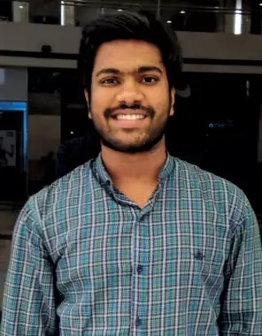
Slide done by Saksham Goyal
Flask Routing
Used the route class of the Flask python library to send and receive data from the webpages.
Used the GET method to receive the data
Used POST method to send the data onto any webpage.
Used ‘ render_template ‘ whenever a new webpage was to be routed to.
Hosted the server on port 8080

Slide 5
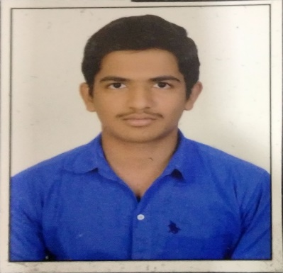


This slide is done by Santhosh Bodla
I developed Front end of our project with the help of HTML , CSS.
Particularly I used CSS Animations for looking more User interactive.
My work consists of seven HTML files which includes Basic html data and CSS Styles.
Index
Input
InputCancer
inputHIV
result
resultCancer
resultHIV

Slide 6

Flow of data
Website starts
Index page
Field One
Second Field
inputCancer page
inputHIV
Processing
Processing
resultCancer
resultHIV

Slide 7


This slide is done by Bosu Sai Sree Ram Charan
Here I am processing the testing and training dataset of cancer obtained from the Kaggle.
Input_File:training_text.csv
Output_File: train_csv.csv
Training_text: A double pipe (||) delimited file that contains the clinical evidence (text) used to classify genetic mutations.
This file contains two fields.
Field-1:ID
Field-2:Text
Train_csv: It is a processed file obtained by removing stop words and performing lemmatization on the training_text file.
This file contains two fields.
Field-1:ID
Field-2:Text
Input_File:test_text.csv
Output_File: test_csv.csv
The above same functionality also has been done for the training text file.

Slide 8
This slide is done by Bosu Sai Sree Ram Charan
Techniques of Natural Language Processing that are used here for processing dataset.
1.Tokenization:It is the process of splitting a string, text into a list of words.
2.Stop_word: These are words which do not contain important significance for predicating the target variable.
3.Lemmatization:Lemmatization, reduces the inflected words(words derived from other words) to root word and ensures
that the root word belongs to the language.
Data Preprocessing Steps:
Step 1: Importing required Libraries.
Step 2: Import the Dataset.
Step 3: Tokenization.
Step 4: StopWord Removal.
Step 5: Lemmatization.
These processed files are used in predicating the target variable for better performance of the model.

Slide 9
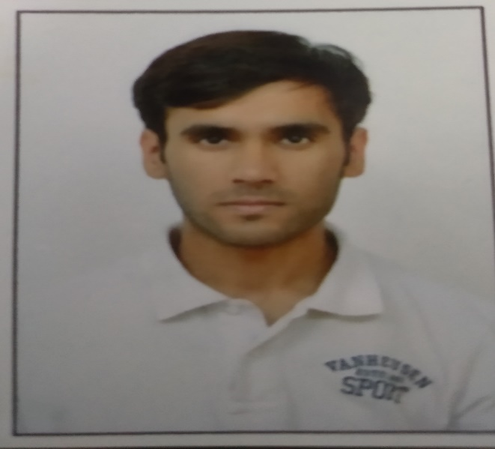
Using ANN to create a model to identify the class of cancer variations
By Kunal Singh

Slide 10

A lot has been said during the past several years about how precision medicine and, more concretely, how genetic testing is going to disrupt the way diseases like cancer are treated.
Once sequenced, a cancer tumor can have thousands of genetic mutations. But the challenge is distinguishing the mutations that contribute to tumor growth (drivers) from the neutral mutations (passengers).
As this interpretation is done manually ,there is a need for methods in which we can quickly identify these mutations.

Slide 11
Dataset
training_variants - a comma separated file containing the description of the genetic mutations used for training. Fields are ID (the id of the row used to link the mutation to the clinical evidence), Gene (the gene where this genetic mutation is located), Variation (the aminoacid change for this mutations), Class (1-9 the class this genetic mutation has been classified on)
training_text - a double pipe (||) delimited file that contains the clinical evidence (text) used to classify genetic mutations. Fields are ID (the id of the row used to link the clinical evidence to the genetic mutation), Text (the clinical evidence used to classify the genetic mutation)
test_variants - a comma separated file containing the description of the genetic mutations used for training. Fields are ID (the id of the row used to link the mutation to the clinical evidence), Gene (the gene where this genetic mutation is located), Variation (the aminoacid change for this mutations)
test_text - a double pipe (||) delimited file that contains the clinical evidence (text) used to classify genetic mutations. Fields are ID (the id of the row used to link the clinical evidence to the genetic mutation), Text (the clinical evidence used to classify the genetic mutation)

Slide 12
I use a sequential model which is essentially a linear stack of layers.
It allows us to create models layer by layer.
The model consists of an input layer ,an output layer along with 2 hidden layers.
As the problem at hand is complex ANN provide us with the ability to learn and model nonlinear and complex relationships which allows it to infer unseen relationships in data. Also ANN do not impose any restrictions on the way input variables should be distributed.

Slide 13

Steps
This slide is done by Shivam Agrawal
Dataset
VL-t0 – viral load is the number of viral particles present in 1 mL of blood.
CD4-t0- The CD4+ cell count is an estimate of the number of white-blood-cells present in 1 mL of blood.
Importing dataset
Scaling the CD4+ cell counts
Appling logistic regression to gain an accuracy of 84%
Saving the model for further predictions using pickle
Using the saved progression model for predictions on user’s input
Libraries like sklearn, pickle and pandas used.

